Slide 1

Seven stages of visualising data
Data Visualisation

Slide 2
Problem?
What do the paths of millions of users through your website look like?
100,000 files on your computer, which ones take up the most space and how often do you use them?
We analyse data to
  highlight its features in order of their importance,
  reveal patterns &
  show features that exist across all dimensions.
Goal is to make use of data as a resource

Slide 3

Data display requires planning
With large datasets we can have different views on the same data.
  Example: Figures of homelessness in Ireland per county
  We need to be clear on what we want from the data

Slide 4
Data collection
Information overload!!!
http://datasmart.ash.harvard.edu/news/article/using-predictive-policing-to-reduce-crime-rate-189
Why have we become better at recording data but not understanding and communicating information?
AOL released a dataset showing search queries of millions of users https://en.wikipedia.org/wiki/AOL_search_data_leak
Data never stays the same, so how do we deal with it?
Notes:
http://prototype.nytimes.com/gst/apitool/index.html

Slide 5
Combination of many disciplines
With the complexity of the data and the goal to provide a meaningful solution we require insights from diverse fields;
      Statistics,
      data mining,
      graphic design and
      Information visualisation

Slide 6
Seven Step Process by Ben Fry
Seven step process to get from our complex data to a visual solution;
Acquire – Obtain the data from a file or source over the network
Parse – Structure the data for the data meaning – order the data into categories / Format the data
Filter – Remove all the data that you are not interested in
Mine – Use data mining techniques to identify patterns or put data in a mathematical context
Represent – choose a visual model – bar chart, map, graph etc.
Refine – Improve the basic representation to make it more visually engaging – improve your first attempt
Interact – Add methods for manipulating the data / controlling what features are available / Drill down & Roll over

Slide 7
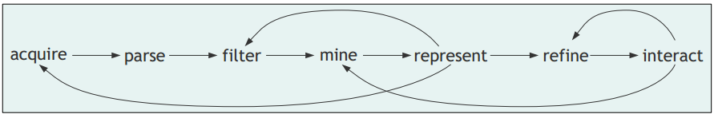
Seven Step Process Diagram

Slide 8
Some principles to take note of
When starting to understand data through to visually representing it, try to do the following;
    Each project has unique requirements
    Avoid all you can eat buffet
    Know your audience

Slide 9
Seven Step Process Example
Click on the link below and go to page 7
http://books.google.ie/books?id=6jsVAiULQBgC&pg=PA1&source=gbs_toc_r&cad=4#v=onepage&q&f=false

Slide 10
Simple example using 7 stages
We will now use the seven stages process to build a visualisation to show the locations of people with no car as obtained by the census in 2006

Slide 11
Acquire
Various different sources we can acquire data from such sample sites like;
New York Times – http://prototype.nytimes.com/gst/apitool/index.html
Fingal County Council - http://data.fingal.ie/ViewDataSets/
Google Public data - http://www.google.ie/publicdata/directory
Amazon public data - http://aws.amazon.com/publicdatasets/
30 places to find data - http://blog.visual.ly/data-sources/

Slide 12
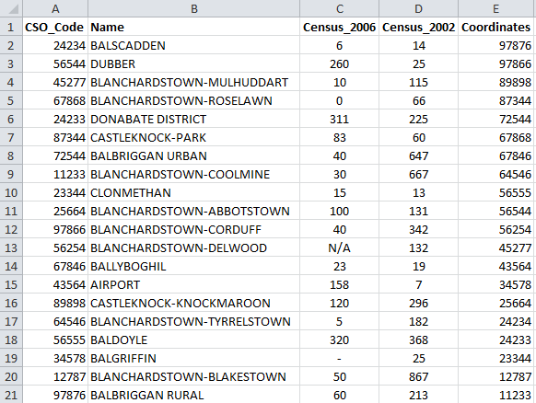
Acquire
Dataset acquired from http://data.fingal.ie/ViewDataSets/

Slide 13
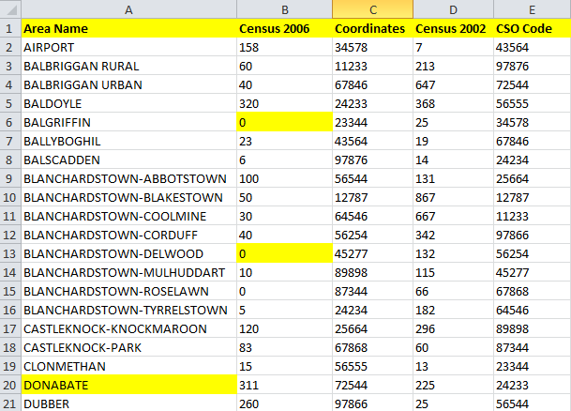
Parse
Structure the data to understand it better and order the data into categories
Group and sort data and clean data
Ordered columns that are more important (Name column first)
Sorted and grouped data (sorted by name and then grouped names – e.g. Blancherstown)
Added clarity to column names (renamed columns and removed _ )
Cleaned data (area name Donabate, missing data, N/A, - and blanks )

Slide 14
Parse continued
Rather than use excel to clean up our data sets we can use Google refine
  https://code.google.com/p/google-refine/
This is currently transitioning over to Google Open Refine
    https://github.com/OpenRefine/OpenRefine
You should spend time here evaluating this software

Slide 15
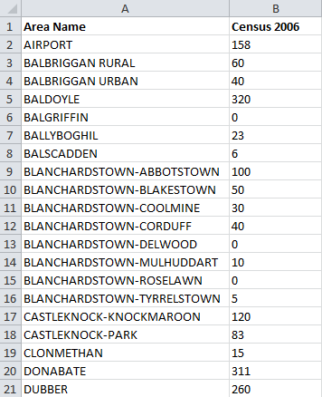
Filter
Remove columns that we are not interested in
  CSO_code
  Census_2002
  Coordinates
I could have kept coordinates
but why did I remove it?

Slide 16
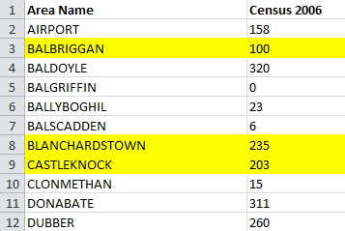
Mine
You can do this phase in Excel or your visualisation tool.
  It depends if you need the individual rows or total rows in your visualisation tool
Statistical calculations are performed on your dataset
In the example below I have just “summed” the areas in yellow

Slide 17
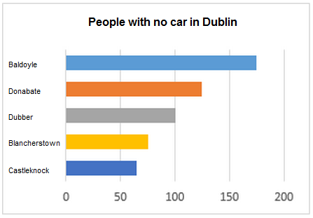
Represent
Here we choose what visual model to use.
  We will use a bar chart

Slide 18
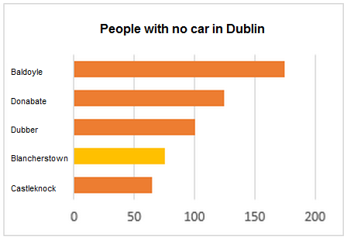
Refine
We can add labels, headings etc. to improve readability
We also colour more appropriately

Slide 19


Interact
Engage your user and provide information when they need it!!

Slide 20
References
Ben Fry (2007). Visualizing Data. 2nd ed. USA: O'Reilly Media. Chapter 1 (The Seven Stages of Visualizing Data)

